Slide 1
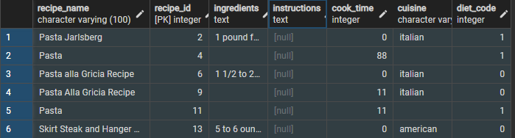
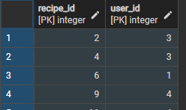
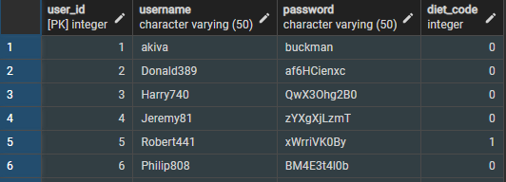
favorites
FK
One-to-many:
A user can have many favorites;
A favorite can only belong to one user
user-favorites
FK
users

